Slide 1

Investigate Hotel Business
Rica Kesuma Mansyur
Mini Project Portfolio

Slide 2
Business Insight
In this Mini Project, I acted as a member of the Data Scientist team in a hotel company. As a member of the Data Scientist team, I have the responsibility to provide insights related to the hotel's business performance. These insights can be sought by data exploration, such as analyzing how customers behave in booking hotel tickets or looking for factors that affect the cancellation of hotel ticket bookings. Then present the insights that have been obtained using visualization and data storytelling.
Dataset
Code

Slide 3

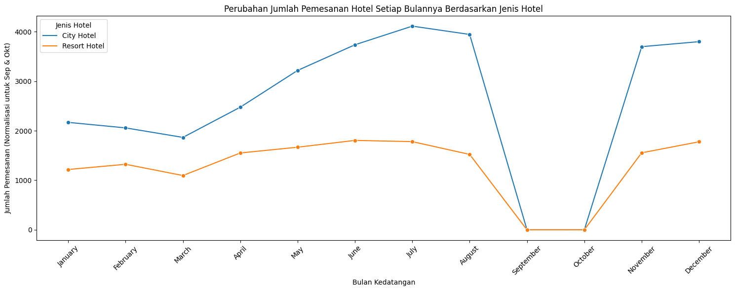
Change in the Number of Hotel Bookings Each Month by Hotel Type
Mercury is the smallest planet
Saturn is a planet with rings
Mars is a cold place
Neptune is very far from the Sun
Earth is the planet with life
Venus has a beautiful name

Slide 4
Interpretation of Plots based on Changes in the Number of Hotel Bookings 2017-2019:
Based on the plot shown above, the number of hotel bookings in September and October each year (2017-2019) is the lowest compared to other months. This has reasons such as in these months do not have long holidays and only September 2017 has a holiday on weekdays, namely on Friday, September 1 commemorating Eid al-Adha and Thursday, September 21 commemorating the Hijri New Year so that hotel bookings only experience a slight increase and the lowest among other months. A comparison of the number of bookings in September and October with the other months in this data shows a very striking difference. In September and October, both at City Hotel and Resort Hotel, the number of bookings experienced a drastic decline that was close to zero. Meanwhile, in other months, the number of bookings tends to be much higher, often in the thousands.
For example, at City Hotel, the number of bookings in the months before and after September and October usually ranges from 1000 to 4000, depending on the year. Whereas in Resort Hotels, the number of bookings ranges from 800 to 1800. This significant difference reflects something unusual happening in September and October. This comparison confirms that there is a special pattern or phenomenon that occurs in September and October that is not seen in other months. Whether this is due to seasonal factors, changes in the recording process, or other external factors, needs further investigation to fully understand. However, it is clear that this period is different from the rest of the year in terms of hotel bookings, and this could have important implications for hotel management in planning and adjusting their business strategies.

Slide 5
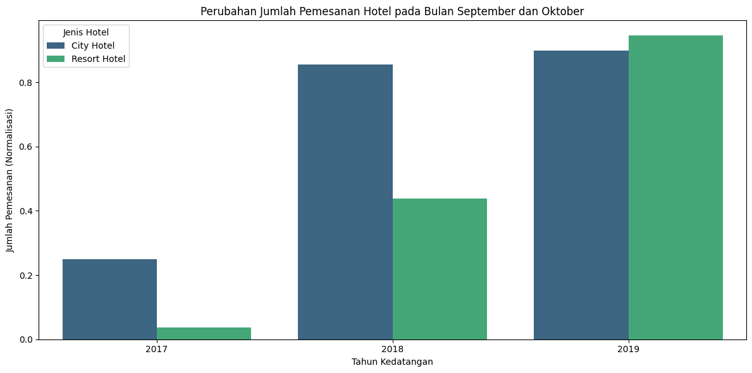
Change in Number of Hotel Bookings in September and October
Mercury is the smallest planet
Saturn is a planet with rings
Mars is a cold place
Neptune is very far from the Sun
Earth is the planet with life
Venus has a beautiful name

Slide 6
Interpretation of Plots in September & October 2017-2018:
In 2017, although there was a holiday in early September, it had the lowest number of hotel bookings compared to the following years. City Hotel has a higher number of hotel bookings than Resort Hotel.
The following year, 2018, the number of hotel bookings experienced a drastic increase compared to last year where it can be concluded that the level of promotion has been getting better at both hotels, especially at City Hotel which increased very drastically than Resort Hotel which experienced a steady increase.
In the following year, 2019, Resort Hotel experienced an increase in the number of hotel bookings than the previous year which was slightly superior to City Hotel which for the last two years the number was superior to Resort Hotel. This can be attributed to the Resort Hotel's better promotional system, fierce competition or the facilities offered are superior to before.

Slide 7
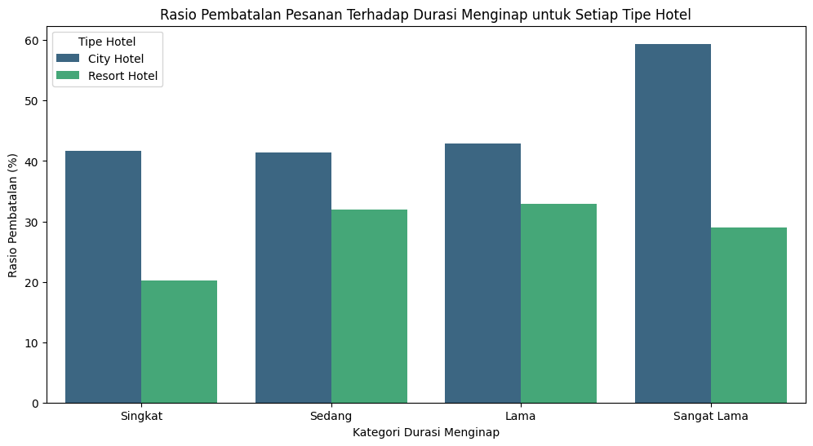
Cancellation Ratio to Stay Duration for Each Hotel Type

Slide 8
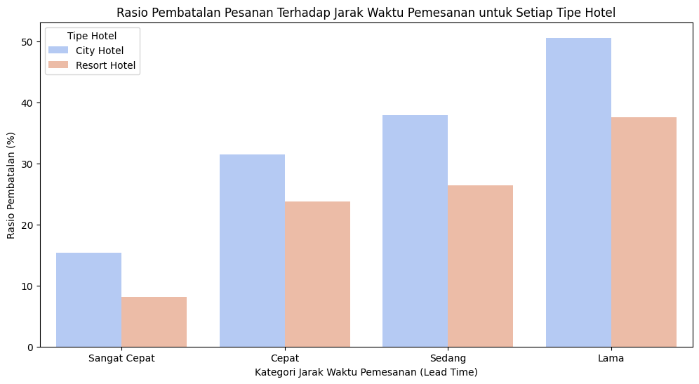
Order Cancellation Ratio to Booking Time Distance for Each Hotel Type

Slide 9
Interpretation of the bar plot showing the ratio of order cancellation to lead time for each hotel type
Very Fast Interval (0 - 12 days):
For bookings with a very fast time interval, City Hotel has a higher cancellation rate compared to Resort Hotel. The cancellation rate is relatively low in this interval, perhaps indicating that bookings with a very short time span tend to be more certain and rarely canceled.
Fast Interval (13 - 27 days):
In this interval, City Hotel also has a higher cancellation rate compared to Resort Hotel. The cancellation rate tends to go up compared to the Very Fast interval, indicating that bookings made earlier may have a higher risk of cancellation.
Medium Interval (28 - 36 days):
Just like the previous interval, City Hotel has a higher cancellation rate. The cancellation rate continues to rise, but the increase is not very significant compared to the Fast interval.
Long Interval (> 36 days):
City Hotel continues to show a higher cancellation rate. The cancellation rate in this interval increased significantly compared to the previous interval. This may indicate that bookings made well in advance are more prone to cancellations.

Slide 10
Conclusion
City Hotel tends to have a higher cancellation rate compared to Resort Hotel across all booking time intervals. There is a pattern of increasing cancellation rates as the booking time interval increases. Bookings made earlier tend to have a higher risk of cancellation. The effect of time interval on the cancellation rate suggests that reservation management strategies and cancellation policies may need to be adjusted based on the time interval of the booking.

Slide 11
Conclusion in terms of business
After conducting various data analysis and visualization to determine the number of bookings and cancellation rates at each hotel, it can be concluded that the two hotels compete with each other in increasing the number of bookings and also try to reduce the cancellation rate so as not to reduce the hotel's revenue and allow to cancel if it occurs in advance of the hotel stay.
Both hotel room sales are fairly stable and nothing is very bad so the competition between the two hotels is quite tight. This is triggered by various reasons such as guests who are comfortable with hotel facilities, distance to strategic tourist destinations, good promotions, and competitive prices.
The thing that must be done to reduce the cancellation rate is to eliminate the cancellation button if you want to book a hotel room or hold a penalty payment if you cancel on the day before lodging so that the cancellation rate is reduced and to increase room bookings is to improve the quality, promotion, and facilities provided.

Slide 12
Thank You
Rica Kesuma Mansyur

